Slide 1

A+ Guide to Hardware:
Managing, Maintaining, and Troubleshooting, 5e
Chapter 9
PC Maintenance and Troubleshooting Strategies
A+ Guide to Hardware modified by Dr. Feda AlShahwan

Slide 2
Objectives
Learn about PC Maintenance and PC maintenance workshop
Learn about operational procedures to keep you, other people, the equipment, and the environment safe
Learn how to develop a preventive maintenance plan and what to include in it
Learn how to approach and solve a PC problem
A+ Guide to Hardware modified by Dr. Feda AlShahwan

Slide 3
Operational Procedures When Supporting Personal Computers
Topics covered
  Introduction to computer maintenance
  Troubleshooting steps, requirements, tools and skills
  Computer maintenance workshop preparation
  Physical dangers that support personal face when maintaining computers
  Sources of damage to the computer and equipment prevention
A+ Guide to Hardware modified by Dr. Feda AlShahwan

Slide 4
Introduction to Computer Maintenance
Computer Maintenance
  Computer Maintenance is basically the same as any other type of maintenance; it includes a set of operations that makes the computer functions properly, runs faster, more efficiently and crashes less than one that has not been maintained
These operations are:
  Repairing the computer: fix and replace the faulty component.
  Preventing and cleaning the computer components: a set of services or procedures performed to keep the computer in good working condition and maintain it for a longer life.
  Upgrading the computer: replace an existing software or hardware with a newer version.
  Troubleshooting: process of identifying a computer problem, tracing the error and fixing it. Begins at outside of the system and moves inwards.
A+ Guide to Hardware modified by Dr. Feda AlShahwan

Slide 5
Computer Troubleshooting
Effective Troubleshooting Requirements:
Finding hardware problems and fixing them is easy. To do effective troubleshooting you need the following:
  Good knowledge of PC.
  Good testing and fixing tools.
  Good reasoning skills.
A+ Guide to Hardware modified by Dr. Feda AlShahwan

Slide 6
Computer Troubleshooting
Troubleshooting Reasoning Skills:
There are, in fact, just six rules you need to know to be able to troubleshoot not just computers, but almost anything. They are also called Six Golden Rules:
Do no harm
Avoid rushing, stop and think. Suppose for example that your system just crashed. You are working hard against a deadline, trying to get a report finished, and you haven’t saved your file for at least half an hour. You are in a rush, so the first thing you want to do is rebooting, which is wrong. The first thing you should do is nothing. In this case, the smartest thing to do is to grab a pen and write down anything that shows on the screen then think about the problem.
A+ Guide to Hardware modified by Dr. Feda AlShahwan

Slide 7
Computer Troubleshooting
Do not overlook the obvious
Pinpoint the problem and then fix it. We use a second medical rule also, because there is at least one other similarity between a doctor diagnosing a medical problem and you diagnose a computer problem. In both cases, you have got to pinpoint the problem before you can do anything to fix it.
When a patient presents with a set of symptoms, the symptoms are most likely due to the most common causes of those symptoms, rather than some exotic disease they just read about in a medical journal. That is why the first question you'll usually get from any hardware company's tech support line is, "Is it plugged in?" It's not because they think you're stupid, and it's not because the people on the first level of the tech support. It’s because most people don't think to check the obvious causes of a problem before they give up. The point is, when something goes wrong, check the obvious things first: Do you see a power light? Is the switch turned on? If the computer is plugged into a power strip, is the switch on the power strip on? Are the cables all connected? Is the fan turning? Is the entire adapter cards solidly seated in their slots? And so on.
A+ Guide to Hardware modified by Dr. Feda AlShahwan

Slide 8
Computer Troubleshooting
Do any part you can
When faced with problem you don't understand do any part of it you do understand then step back and look at the problem again.
So start solving the problem with any thing you know. And in the more likely event that you don't solve the problem immediately from doing the parts you understand, the results of whatever you do may give you an idea about what to do next. If not, at least you will know that you have done what you can, before giving up and handing the job over to someone else.
Simplify
The simpler you can make your system the fewer things you need to look when tracing a problem. If you can test for a problem without Microsoft running, for example, you do not have to consider a software conflict in Windows as the source of the problem. If you can’t test without Microsoft Windows running, you can at least close all programs that are not necessary, which eliminates those programs from the equation. If you can remove other hardware plugged into your system's ports, you can eliminate that hardware as the source of the problem.
A+ Guide to Hardware modified by Dr. Feda AlShahwan

Slide 9
Computer Troubleshooting
And if you can remove some adapter cards from your computer, you have that many fewer adapter cards to consider as possible sources of the problem. The point is that the more you can simplify the system you're testing, the fewer things you have to look at to find the problem.
Bracket.
There is enough overlap between simplifying and bracketing that it's hard to draw a sharp distinction between them. Bracketing is most easily understood in context of a game we'll call Guess the Number. Suppose you have a printing problem, for example. At the risk of oversimplifying, there are five possible sources of the problem: The software you're printing from, the printer driver (the software that tells Windows how to print with the particular printer), the computer hardware, the cable, and the printer. Run the printer's self test. If the printer works then the problem lies somewhere between the application program and the connector on the printer. If it doesn't work, the problem is in the printer itself, and you can look at things like whether it has any ink or toner left.
A+ Guide to Hardware modified by Dr. Feda AlShahwan

Slide 10
Computer Troubleshooting
(Or paper. Remember Rule 2: Don't overlook the obvious.) Either way, you've bracketed the problem and have fewer things to look at. Bracketing overlaps with simplifying, because one of the ways to bracket a problem is to simplify your system. With a printing problem, for example, if the printer is plugged into some other hardware, one bracketing step you'll want to try is to remove the other device, which also simplifies the system. In much the same way, when you simplify your system, you may find that a problem disappears in which case you've effectively bracketed the problem by showing it's related to whatever you eliminated. You can then add things back to help pinpoint the item that's causing the problem. Whether you get to this point by thinking about simplifying your system or thinking about bracketing the problem, however, doesn't matter. What matters is that you get there.
A+ Guide to Hardware modified by Dr. Feda AlShahwan

Slide 11
Computer Troubleshooting
Swap out
Swapping out doesn't overlap with simplifying, but it certainly overlaps with bracketing a problem. The idea behind swapping out is simple. Suppose you have two flashlights. One works; the other doesn't. The problem with the one that doesn't work could be bad batteries or a bad bulb. Swap the batteries and see what happens. If the problem goes with the batteries to the second flashlight, you need new batteries. If the problem stays with the same flashlight only, you need a new bulb. If both flashlights now have a problem, you need new batteries and a new bulb.
The swapping out overlaps with bracketing, because sometimes the only way to bracket a problem is to swap out some pieces. Returning to printer problems, for example, swapping printers will tell you if the problem goes with the printer or with the rest of the system, which in turn helps you bracket the problem. And swapping cables is the easiest way to decide whether you have a problem with the cable. Whether you think of what you're doing as swapping out or as bracketing doesn't matter, as long as you get around to swapping the cables.
A+ Guide to Hardware modified by Dr. Feda AlShahwan

Slide 12
Computer Troubleshooting
Troubleshooting Steps:
What are the steps a technician should follow in order to solve a computer problem? How to troubleshoot a PC problem?
Approach the problem first as an investigator and discoverer
  Do not compound the problem
  Ask questions until problem source understood
  Positive attitude
Use a systematic method to solve a problem
A+ Guide to Hardware modified by Dr. Feda AlShahwan

Slide 13
How to Troubleshoot a PC Problem
Troubleshooting steps
  Gather information, Interview the user and back up data before changes are made
  Examine the system, watch up boot up procedure, analyze the problem, make an initial determination
  Test theory
  After problem source determined
    Plan what to do to fix the problem and then fix it
  Verify problem is fixed and system works
    Take preventive measures to make sure problem does not happen again
  Document activities, outcomes, and knowledge learned
A+ Guide to Hardware modified by Dr. Feda AlShahwan

Slide 14
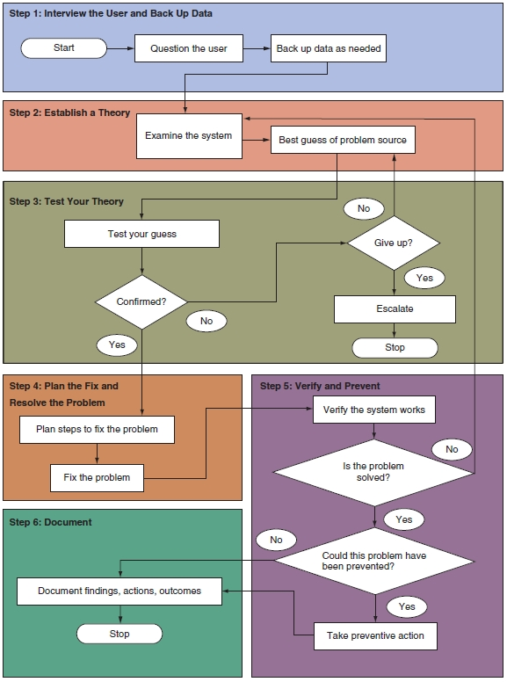
Figure 9-1 General approach to problem solving. Courtesy: Course Technology/Cengage Learning
A+ Guide to Hardware modified by Dr. Feda AlShahwan

Slide 15
Step 1: Interview the User and Back Up Data
Beginning of troubleshooting situation
  Gather information, Interview user
    Can you please describe the problem, including error messages, failures, and what you see or hear?
    What changes have recently been made to the system?
    Is there important data on the system that is not backed up?
    Can you show me how to reproduce the problem?
  Ask more penetrating questions to obtain all information to help solve the problem
A+ Guide to Hardware modified by Dr. Feda AlShahwan

Slide 16
Step 1: Interview the User and Back Up Data (cont’d.)
  Back up any important data
    Risks with the data must be the user’s decision
    Have user verify all important data safely backed up
A+ Guide to Hardware modified by Dr. Feda AlShahwan

Slide 17
Step 2: Examine the System, Watch Boot up Procedure and Make Your Best Guess
Steps to form a best guess (best theory) and test it
  Reproduce the problem and observe what the user described
  Watch boot up sequence
    What is boot up? Bootstrapping is the process of starting up a computer from a halted or powered-down condition. When the computer is switched on, it activates the memory-resident code, which resides on the CPU board. The normal facilities of the operating system are not available at this stage and the computer must pull itself up by its own boot-straps so to speak. This procedure therefore is often referred to as bootstrapping, also known as cold boot.
A+ Guide to Hardware modified by Dr. Feda AlShahwan

Slide 18
Step 2: Examine the System, Watch Boot Up Procedure and Make Your Best Guess
  Types of boot up
  • Cold boot up: system started from off condition when power applied, and this is performed by turning on the power switch.
  • Warm boot up: Refers to restarting a computer that is already turned on via the operating system it returns the computer to its initial state. A warm boot is sometimes necessary when a program encounters an error from which it cannot recover. On PCs, you can perform a warm boot by pressing the Control, Alt, and Delete keys simultaneously, Reset button, Restart or F9. Also called a soft boot.
A+ Guide to Hardware modified by Dr. Feda AlShahwan

Slide 19
Step 2: Examine the System, Watch Boot Up Procedure and Make Your Best Guess
Bootup Main Operations:
  Booting the PC includes a set of the following operations.
  1. POST: The POST is a built-in diagnostic program that checks your hardware to ensure that everything is present and functioning properly.
  2. Initialization: BIOS places starting values in system’s various intelligent devices.
  3. BIOS load Operating System (OS) on the active partition.
A+ Guide to Hardware modified by Dr. Feda AlShahwan

Slide 20
Step 2: Examine the System, Watch Boot Up Procedure and Make Your Best Guess
  Bootup Steps:
  Carefully observing the steps of a boot-up procedure can reveal a great deal about the nature of problems in a system. Faulty areas can be included or excluded from possible causes of errors during the boot-up process.
  The observable actions of a working system’s cold boot procedure are listed as follows as their order of occurrence; for warm boot up steps 1 – 4 are bypassed:
  When power is applied, the power-supply fan activates.
  The keyboard lights flash as the rest of the system components are being reset.
A+ Guide to Hardware modified by Dr. Feda AlShahwan

Slide 21
Step 2: Examine the System, Watch Boot Up Procedure and Make Your Best Guess
  A Basic Input Output System (BIOS) message displays on the monitor.
  A memory test flickers on the monitor.
  The floppy disk drive access light comes on briefly.
  The hard disk drive access light comes on briefly.
  The system beeps, indicating that it has completed its Power-On Self-Tests and initialization process.
  The floppy disk drive access light comes on briefly before switching to the hard drive. At this point, the BIOS is looking for additional instructions (boot information), first from the floppy drive and then from the hard drive (assuming the CMOS setup is configured for this sequence).
  For Windows machines, the Starting Windows message appears onscreen.
A+ Guide to Hardware modified by Dr. Feda AlShahwan

Slide 22
Step 2: Examine the System, Watch Boot Up Procedure and Make Your Best Guess
  Memorize the order of the series of observable events that occur during the normal (DOS) boot up. If a section of the computer is defective, you will observe just some (or possibly none) of these events. By knowing the sections of the computer involved in each step, you can suspect the section that is causing the problem.
  For instance, it is illogical to replace the floppy disk drive (step 5) when a memory test (step 4) has not been displayed on the monitor.
  Therefore, when a failure occurs, you can eliminate components as a possible cause of the error by observing the number of steps the system completes in the preceding list. You can eliminate those subsystems associated with steps successfully completed. Focus your efforts only on those sections responsible for the symptom. When that symptom is cleared, the computer should progress to another step.
A+ Guide to Hardware modified by Dr. Feda AlShahwan

Slide 23
Step 2: Examine the System, Watch Boot up Procedure and Make Your Best Guess
  Decide if the problem is hardware or software related
  Make a best guess of problem source
    Search resources for ideas and tips if necessary
Identifying the source of problem
A functional computer system is composed of two major parts: the system's hardware and the software that controls it. These two elements are so closely related that it is often difficult to determine which part might be the cause of a given problem. Therefore, one of the earliest steps in troubleshooting a computer problem (or any other programmable system problem) is to determine whether the problem is due to a hardware failure or to faulty programming.
A+ Guide to Hardware modified by Dr. Feda AlShahwan

Slide 24
Step 2: Examine the System, Watch Boot up Procedure and Make Your Best Guess
Identifying the source of problem (cont.)
In PCs, you can use a significant event that occurs during the boot-up process as a key to begin separating hardware problems from software problems: the single beep most PCs produce between the end of the POST and the beginning of OS load process (step 7 in the preceding list). Errors that occur, or are displayed, before this beep indicate that a hardware problem of some type exists. This conclusion should be easy to understand because up to this time, only the BIOS and the basic system hardware have been active. The operating system side does not come into play until after the beep occurs.
If the system produces an error message (such as "The System Has Detected Unstable RAM at Location x") or a beep code before the beep, for example, the system has found a problem with the RAM hardware. In this case, a bad memory device is indicated.
A+ Guide to Hardware modified by Dr. Feda AlShahwan

Slide 25
Step 2: Examine the System, Watch Boot up Procedure and Make Your Best Guess
Identifying the source of problem (cont.)
You can still group errors that occur before the beep into two distinct categories: configuration/ setup errors and hardware failures.
  Configuration Problems: You can trace most of all problems that occur in computer systems back to configuration settings.
  A special category of problems tends to occur whenever a new hardware option is added to the system, or when the system is used for the very first time. These problems are called configuration problems, or setup problems, and result from mismatches between the system's programmed configuration, held in CMOS memory, and the actual equipment installed in the system.
  This mismatch also can be between the system's CMOS configuration settings and the option's hardware jumper or switch settings.
A+ Guide to Hardware modified by Dr. Feda AlShahwan

Slide 26
Step 2: Examine the System, Watch Boot up Procedure and Make Your Best Guess
CMOS Setup Utility and Plug and Play
In most newer systems, the BIOS and operating system use Plug and Play (PnP) techniques to detect new hardware that has been installed in the system. These components work with the device to allocate system resources for the device. In some situations, the PnP logic cannot resolve all the system's resource needs and a configuration error occurs. In these cases, you must manually resolve the configuration problem.
Configuration problems occur with some software packages when first installed. The user must enter certain parameters into the program to match its capabilities to the system's actual configuration using CMOS setup utility. These configuration settings are established through the startup software in the ROM BIOS. If these parameters are set incorrectly, the software cannot direct the system's hardware properly and an error occurs.
A+ Guide to Hardware modified by Dr. Feda AlShahwan

Slide 27
Step 2: Examine the System, Watch Boot up Procedure and Make Your Best Guess
Normally, you need to run the system's CMOS Setup utility in these three situations:
When the system is first constructed.
If it becomes necessary to replace the CMOS backup battery on the system board.
Whenever a new or different option is added to the system (such as a hard drive, floppy drive, or video display).
A+ Guide to Hardware modified by Dr. Feda AlShahwan

Slide 28
Step 3: Test Your Theory
Examples where Steps 3, 4, and 5 go very fast
  Video does not work
    Suspect loose cables or monitor not turned on
    Check video cable connection and discover it’s loose
    Screw video cable to the connection
  Corrupted spreadsheets
    Watch user save a file
    Discover user is saving files in a wrong format
    Step the user through saving the file correctly
    Verify others can open the file
    Explain to the user which format to use
A+ Guide to Hardware modified by Dr. Feda AlShahwan

Slide 29
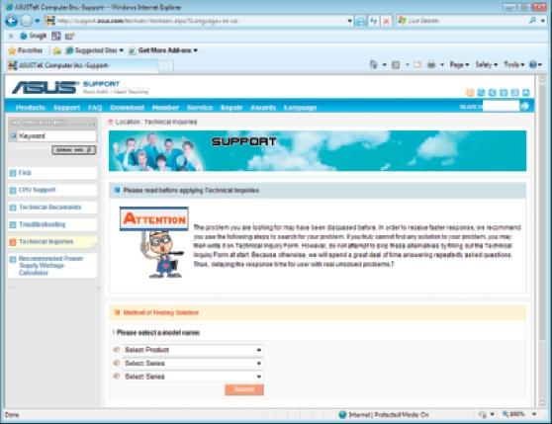
Figure 9-2 Search manufacturer Web sites for help with a hardware or software product. Courtesy: Course Technology/Cengage Learning
A+ Guide to Hardware modified by Dr. Feda AlShahwan

Slide 30
Step 3: Test Your Theory (cont’d.)
Examples of Step 3 which include testing an incorrect guess
  CD drive won’t read a CD, suspect CD scratched
    Disc looks fine upon inspection
    Next guess: CD drive not recognized by Windows
    Device Manager reporting drive errors
    Next guess: corrupt drivers
  System refuses to boot and gives hard drive not found message
    Internal cable connections solid
    Next guess: power supply not supplying power to the drive
A+ Guide to Hardware modified by Dr. Feda AlShahwan

Slide 31
Step 3: Test Your Theory (cont’d.)
Examples of Step 3 with a correct guess, move on toward Step 4 to plan a solution
  Corrupted Word files
    Eliminate several simple causes
    Guess bad hard drive
    Event Viewer shows write errors to the drive
    Bad drive theory confirmed
    Will need to replace drive
A+ Guide to Hardware modified by Dr. Feda AlShahwan

Slide 32
Step 3: Test Your Theory (cont’d.)
Examples of Step 3 with a correct guess, move on toward Step 4 to plan a solution (cont’d.)
  Video does not work
    Check cables, power, and monitor settings
    Exchange video cable with known good one
    Guess a bad monitor: move monitor to a working PC and it still does not work
    Try a good monitor on the first PC: works fine
    Bad monitor confirmed
    Plan to purchase new monitor
A+ Guide to Hardware modified by Dr. Feda AlShahwan

Slide 33
Step 3: Test Your Theory (cont’d.)
As testing of guesses proceeds, keep in mind the following rules:
  Use the six troubleshooting skills
  Divide and conquer (Bracketing)
  Become a researcher
  Write things down
  Don not overlook the obvious or assume the worst
  Reboot and start over
A+ Guide to Hardware modified by Dr. Feda AlShahwan

Slide 34
Step 4: Plan Your Solution and Then Fix the Problem
Some solutions are expensive and time consuming
Carefully consider what will be done and the order
A+ Guide to Hardware modified by Dr. Feda AlShahwan

Slide 35
Step 4: Plan Your Solution and Then Fix the Problem (cont’d.)
Steps to plan a solution and fix the problem:
  Consider different solutions
    Select the least invasive one
  If hardware needs replacing:
    Select a replacement part compatible with the system
  Before installing a new part
    Determine what works and does not work
    Provides starting point
  Install the new part
A+ Guide to Hardware modified by Dr. Feda AlShahwan

Slide 36
Step 5: Verify the Fix and Take Preventive Action
Checks:
  Try reaching the Internet, use the printer, and burning a CD
  Have user check everything and verify the job was completed satisfactorily
    If a problem is found return to Step 2
  After verification consider how problem could have been prevented
    Instruct the user to do what is appropriate to prevent future problems
A+ Guide to Hardware modified by Dr. Feda AlShahwan

Slide 37
Step 6: Document What Happened
Good documentation helps the technician:
  Take knowledge learned into next troubleshooting situation
  Train others
  Develop effective preventive maintenance plans
  Satisfy any audits or customer or employer queries about your work
A+ Guide to Hardware modified by Dr. Feda AlShahwan

Slide 38
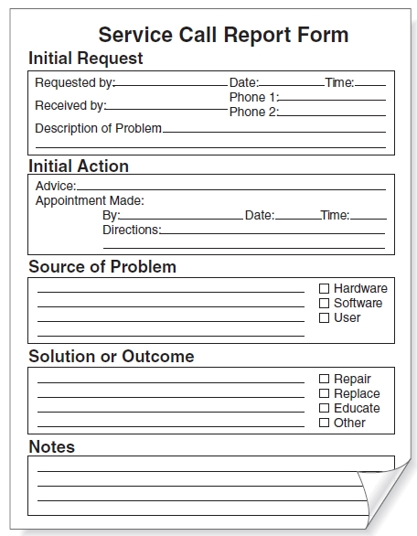
Figure 9-3 Service call report form
Courtesy: Course Technology/Cengage Learning
A+ Guide to Hardware modified by Dr. Feda AlShahwan

Slide 39
Stay Safe and Keep Components Safe
Safety Tips: User
Turn off power
Do not get inside monitors and power supplies because they contain capacitors that store and hold charges even after they are turned off.
Certain components such as resistors and vacuum tubes get hot give them time to cool before touching them.
Avoid chemical burns
Managing cables
  Avoid trip hazard, cables that can cause people to trip
  Use cable or cord cover
  Nail or screw to floor
Sharp edges in and around case
A+ Guide to Hardware modified by Dr. Feda AlShahwan

Slide 40

Stay Safe and Keep Components Safe (cont’d.)
Proper use of cleaning pads and solutions
  Most contain flammable and poisonous materials
    Keep away from skin and eyes
Figure 9-4 Cleaning solutions and pads. Courtesy: Course Technology/Cengage Learning
A+ Guide to Hardware modified by Dr. Feda AlShahwan

Slide 41

Stay Safe and Keep Components Safe (cont’d.)
Proper use of cleaning pads and solutions (cont’d.)
  Accidental exposure procedures
    View Material Safety Data Sheet (MSDS)
    Know company reporting policies
Figure 9-5 Each chemical you use should have available a material safety data sheet. Courtesy: Course Technology/Cengage Learning
A+ Guide to Hardware modified by Dr. Feda AlShahwan

Slide 42
Stay Safe and Keep Components Safe (cont’d.)
Heavy equipment that can hurt a technician’s back
How to Lift heavy objects?
  Put on a cart
  Guidelines
    Balance the load when lifting
    Stand close to the object with feet apart
    Keep back straight, bend knees, and grip the load
    Lift with legs, arms, and shoulders
    Keep load close to body and avoid twisting
    Put the object down by keeping back straight and lowering object by bending knees
  Ask for help if necessary
A+ Guide to Hardware modified by Dr. Feda AlShahwan

Slide 43
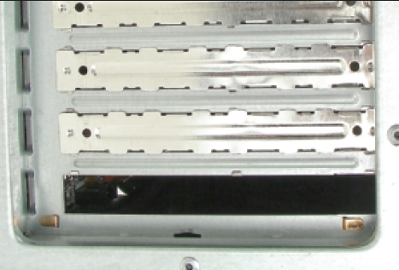
Stay Safe and Keep Components Safe
Safety Tips: Components
Unplug immediately the PC when damaged physically, exposed to water, moisture, or electrical shorts
Handle boards by edges and avoid touching silver or gold contacts because oil from your fingers can create an insulating layer and degrade electrical signals
Keep magnets away from the computer
No liquids, jewelers or metallic objects that conduct electricity
Do not move or jar computer when on
Do not smoke around the computer
Do not leave PC turned off for weeks or months
Do not block air vents on the case or monitor
Figure 9-6 For optimum airflow, don’t leave empty expansion slots and bays uncovered. Courtesy: Course Technology/Cengage Learning
A+ Guide to Hardware modified by Dr. Feda AlShahwan

Slide 44
Stay Safe and Keep Components Safe
Guidelines (cont’d.)
  Use keyboard covers in dirty environments
  Avoid high humidity around hard drives
  Use BIOS setup to disable ability to write to the hard dive boot sector
  Keep private data under lock and key
  Protect storage media from direct sunlight, heat, and extreme cold
  Protect electrical equipment from power surges
  Protect system from the Electro Static Discharge (ESD)
A+ Guide to Hardware modified by Dr. Feda AlShahwan

Slide 45
Electro Static Discharge
What is ESD?
Electro Static Discharge
Electrical charge at rest that suddenly flows and passes between two objects of dissimilar charges when contacted with each other. This might cause an electrical short or dielectric breakdown
Form of result of EMI (Electro Magnetic Interface)
Static can discharge through computer equipment which are made of MOS (Metal Oxide Semiconductor) Why? They contain thin metal oxide material that is conductive and sensitive to ESD (10 volts can destroy and damage electronic component)
CPU/ Memory are most sensitive to ESD
A+ Guide to Hardware modified by Dr. Feda AlShahwan

Slide 46
Electro Static Discharge
Causes of ESD:
Low humidity.
Unshielded cables.
Improper grounding.
People movement.
How Decrease ESD?
Increase humidity by using humidifier
Use shielded cables.
Good grounding.
Discharge ESD. How?
  Antistatic wrist strap.
  Antistatic mat.
  Plug PC with switch off and touch the chassis
Use antistatic sprays.
A+ Guide to Hardware modified by Dr. Feda AlShahwan

Slide 47
Workshop
Table to rest the device with the following specifications:
  Flat
  Light color
  Large enough
  Made from wood
Power receptacles
Emergency button x.
Note: Plug cable (electricity) has 0.03V sensitivity while light has 0.3V sensitivity.
Good lighting
Lamps
Magnifying glass: to read small part numbers and to see cracked wires
Fire extinguisher
Tools for troubleshooting
A+ Guide to Hardware modified by Dr. Feda AlShahwan

Slide 48
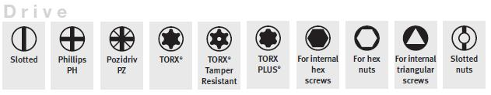
Work Shop
Troubleshooting tools
Software tools
  Built in (POST)
  Programs (Anti virus – Norton Doctor )
  General purpose diagnostic tools. ( Check it – PC Check)
Hardware tools
Hand tools
  Screw drivers: Open and fasten screws
1- Slotted 2- Philips 3- Torx 4- Nut
  Pliers: Cut wires and cables
  Tweezers: Catch and hold small items
  IC puller: install and uninstall chips
Figure 9-7 Types of screw drivers. Courtesy: Course Technology/Cengage Learning
A+ Guide to Hardware modified by Dr. Feda AlShahwan

Slide 49
Workshop
Organizational Aids
  Parts Organizer
  Notebook
  Masking tape
ESD tools
  Antistatic wrist strap: an elastic fabric band fits over your wrist that has a cord attached with a clip on the end. The clip is connected it to a bare metal part of computer chassis to allow for a proper electrical ground. In addition, the strap contains a resistor that prevents electricity from harming the technician
  Antistatic Mat: a conductive mat used in conjunction with the wrist strap. It has very high resistance to discharge the static charges slowly
  Antistatic bags: shielded bags used for shipping new components that protect against an electromagnetic field
A+ Guide to Hardware modified by Dr. Feda AlShahwan

Slide 50
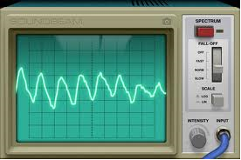
Workshop
Testing (diagnostic) tools: Used to test and diagnose the computer components
  Oscilloscope: Electronic testing equipment used to observe the electronic signal on its screen, usually as a two-dimensional graph of one or more electrical potential differences using the vertical or y‑axis, plotted as a function of time (horizontal or x‑axis).
Figure 9-8: Oscilloscope
    Post card reader: A card that is placed in one of the PC's expansion slots and reads the codes generated by the BIOS (during power on) and displays hexadecimal number on its LED.
A+ Guide to Hardware modified by Dr. Feda AlShahwan

Slide 51
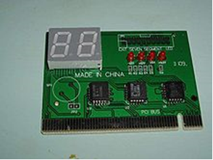
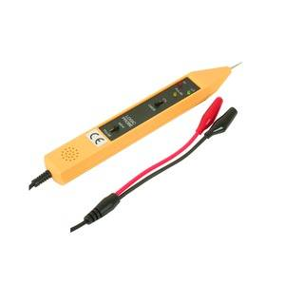
Workshop
    POST card reader is used for troubleshooting computers that do not startup (monitor and/or speaker). However, it relies on a working BIOS.
Figure 9-9: POST card reader
  Logic probe: A handheld pen like electronic device, with electron on its tip and wires from the other end (see Figure 1). It is used to indicate the status of the voltage at specific instance, normally using an LED as the indicator. Often the LED on the logic probe will use different colors to indicate different states. A logic probe is a cheap and relatively simple item of test equipment. It is versatile and very transportable, and it is also able to provide a quick test for many circuits. However, it is not nearly as flexible and precise as an oscilloscope
Figure 9-10: Logic Probe
A+ Guide to Hardware modified by Dr. Feda AlShahwan

Slide 52
Workshop
  Multimeter: It is an electronic handheld measuring instrument that combines several measurement functions in one unit. It is used to measure the values of voltage, current, continuity and resistance
Types of Mutlimeters:
  1. Digital (DMM): display digits proportional to the measured value.
  More precise.
  Easier to use and read.
  More reliable to operate error.
  2. Analog (VOM): analog instruments are usually based on a micrometer whose pointer moves over a scale calibrated for all the different measurements that can be made.
Note: In computers no need to use current function
A+ Guide to Hardware modified by Dr. Feda AlShahwan

Slide 53
Workshop
How to use Multimeter?
- Select the proper function: Volt power on
Resistance power off
Continuity power off
Steps to measure volt (power on):
- Select the proper function which is voltage (V)
- Select voltage type (AC, DC)
Note : Most measurements in computers are DC voltage
Note : AC measurements: commercial power being applied to the power supply
Ripple voltage from DC output side of power supply.
- Set the meter to its highest range to prevent it from damage
- Connect it parallel to the tested components
- After detecting approximate value decrease the range setting to achieve more accurate reading
- DC reading in PC: +12 & -12 Volt,+5 & -5 Volt and +3.3 Volt
Note: Most multimeters allow for overvoltage protection
A+ Guide to Hardware modified by Dr. Feda AlShahwan

Slide 54
Workshop
Steps to measure resistance (power off):
- Select the proper function
- Set the meter to its lowest (1K) range to prevent the meter from damage.
- Connect it serial to the tested components.
- After detecting approximate value increase the range setting to achieve more accurate reading
- Used to test fuse, speakers, cable
- For the speaker:
0 speaker is short-circuit and defective
∞ speaker is open-circuit and defective.
-8 ohms speaker is working properly
- For the cable:
0 tested components are working properly.
∞ tested component is defective
A+ Guide to Hardware modified by Dr. Feda AlShahwan

Slide 55
Workshop
Steps to measure continuity (power off):
- Select the proper function
- Connect the tested component in parallel
Beep sound component is working.
No beep component is deductive.
A+ Guide to Hardware modified by Dr. Feda AlShahwan

Slide 56
Personal Computer Preventive Maintenance
Prevent computer problems from occurring in the first place
PC technicians responsibilities
  Make and implement a preventive maintenance plan
  Create a disaster recovery plan
Preventive maintenance goals
  Reduce likelihood of events causing PC failures
    Lessen the damage if they do occur
A+ Guide to Hardware modified by Dr. Feda AlShahwan

Slide 57
Set Up a Method of Documentation
Create a new computer record book
  Record changes in setup data, problems experienced, and maintenance performed
  Keep it up to date
  Store it with hardware and software documentation
A+ Guide to Hardware modified by Dr. Feda AlShahwan

Slide 58
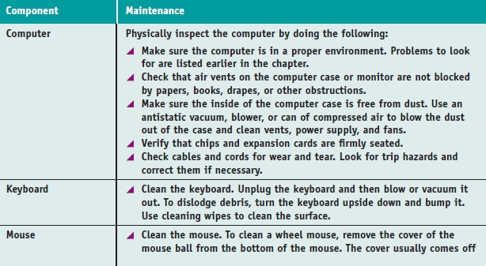
Create a Preventive Maintenance Plan
Evolves from a history or pattern of malfunctions within an organization
Table 9-2 Guidelines for developing a PC preventive maintenance plan
A+ Guide to Hardware modified by Dr. Feda AlShahwan

Slide 59
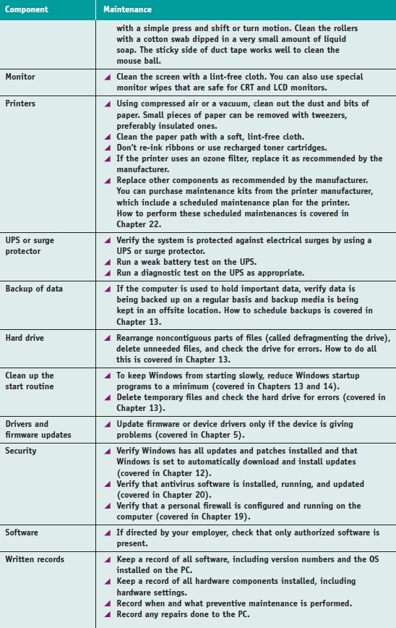
Table 9-1 Guidelines for developing a PC preventive maintenance plan (continued)
A+ Guide to Hardware modified by Dr. Feda AlShahwan

Slide 60
Summary
Introduction to computer maintenance and effective troubleshooting requirements
Specifications for computer maintenance workshop
Operational procedures in the PC support role
  Know physical dangers when maintaining computers
  Know damage sources to computers and equipment
Preventive maintenance goals
  Reduce likelihood of events causing PC failures
  Lessen damage if they do occur
PC troubleshooting involves six steps and six golden rules
A+ Guide to Hardware modified by Dr. Feda AlShahwan

